Slide 1
Building new boxes

Slide 2

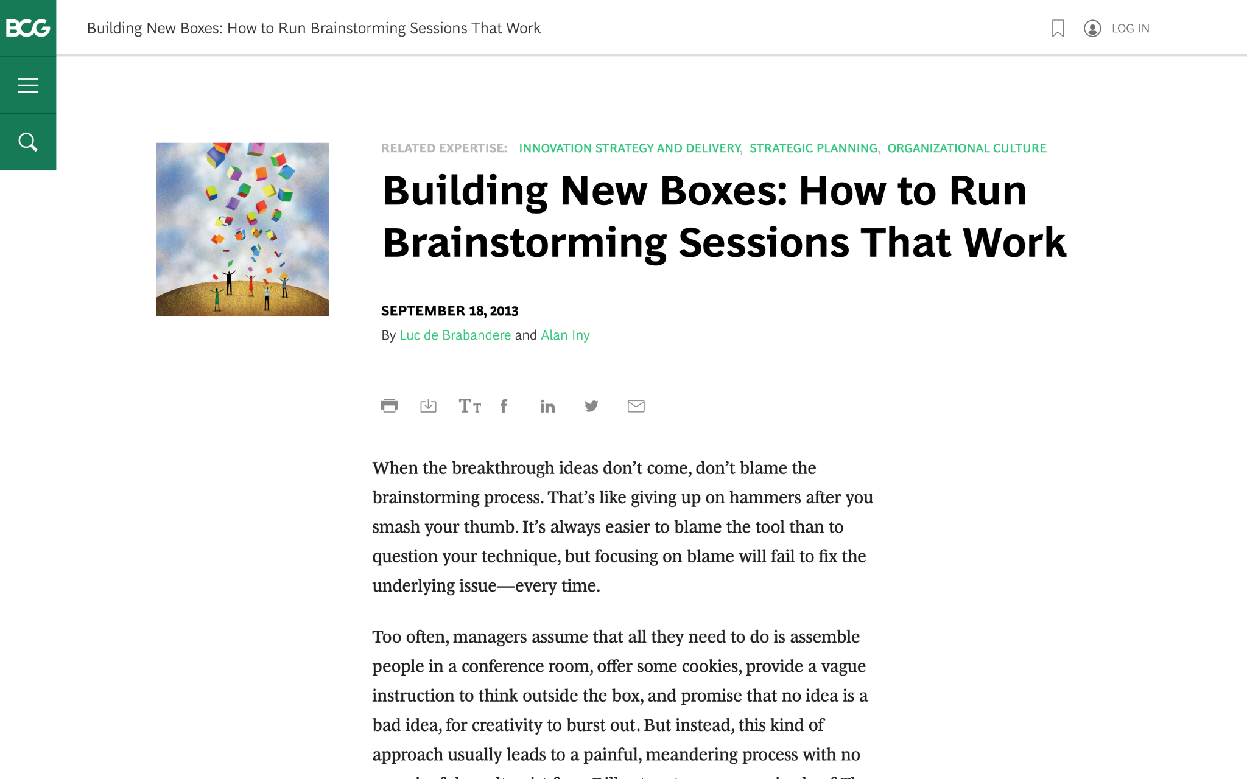
We are going to discuss effective brainstorming for our partnered clothing brand

Slide 3

The article offers five suggestions to achieve real, valuable insights from brainstorming
We will focus on three of these in today’s task (as well as the brainstorming itself), highlighted in green
1.
CORE ISSUE
2.
CURRENT MARKET
3.
COMPETITOR LANDSCAPE
4.
GROWTH OPPUTUNITIES
5.
Follow up
Brainstorm

Slide 4

STRATEGIC RECOMMENDATION
MARKET EXPANSION
BRAND AWARENESS
PRODUCT DEVELOPMENT
COMPETITOR ADVANTAGE
GROWTH OPPURTUNITIES

Slide 5

QUESTIONS TO BE ASKED
HOW
WHEN
WHAT
This Photo by Unknown Author is licensed under CC BY-NC

Slide 6
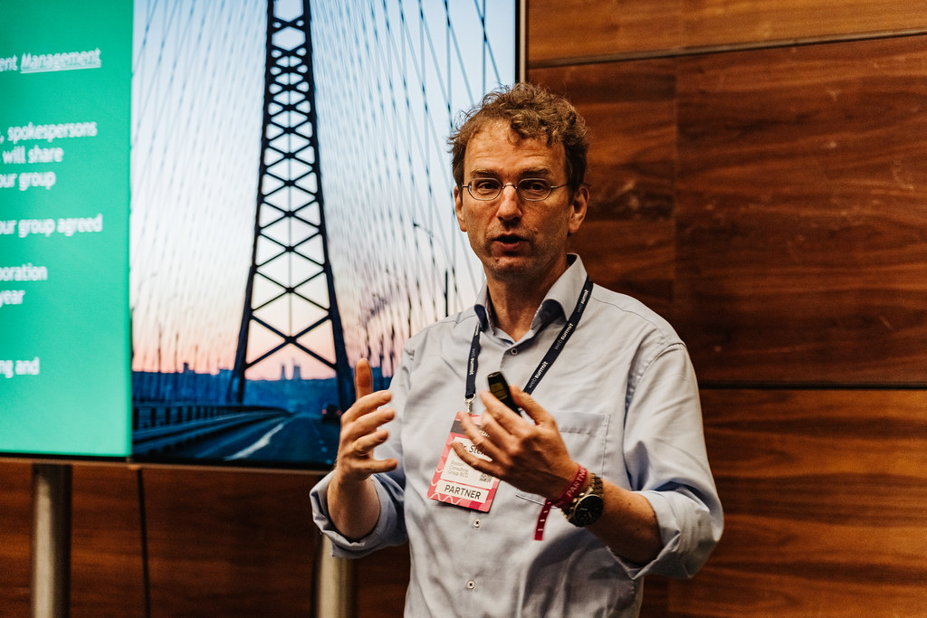
IMPLEMENTATION PLAN
MARKET RESEARCH AND ENTRY STRATEGY
BRAND BUILDING AND MARKETING
PRODUCR ROLLOUT AND MONITORING

